Slide 1
Open AI Hackathon
INSTRUCTIONS: To change image
> Click on View > Slide Master
> Click on the image again > Hit delete > Insert or drag your new image
> Right click on the new image ’Send to Back’ to reveal the text
> Crop and adjust the image appropriately
> Branding Zone Link for images
Crop Recommendations
17 April 2024

Slide 2
Problem Statement
Crop recommendations
We are trying to predict suitable Crops based on available soil type and climatic conditions

Slide 3
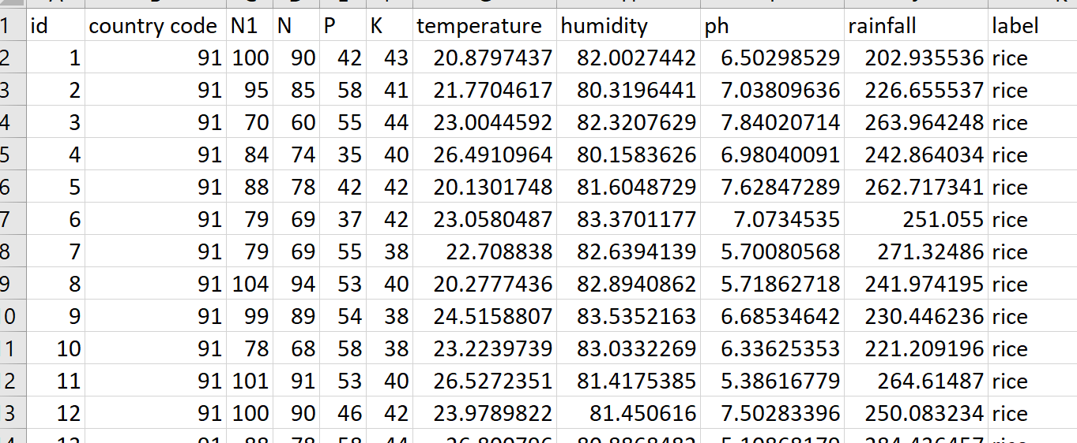
Example Data

Slide 4
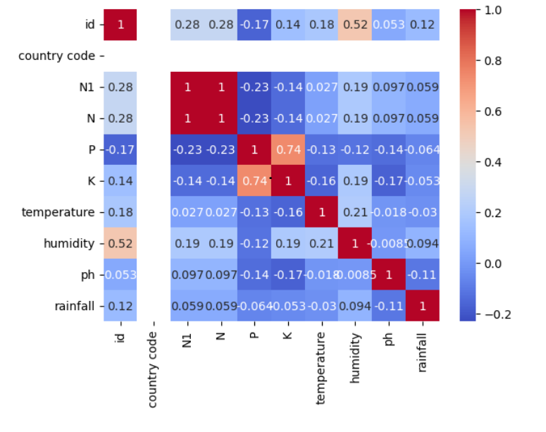
Evaluation Steps
Data Load
Dividing into test and train data as xtrain, xtest, ytrain and ytest
Apply Correlation
Removing Matchable correlation columns (N1)
Independent column (Country Code)
HeatMap

Slide 5
Evaluation Steps Contd..
Data Normalization
Z Scale
(treated outliners)
Best Model
Models Considered
DecisionTreeClassifier SVC(kernel='linear’)
(Accuracy = 0.9931818) (Accuracy = 0.9841818)
RandomForestClassifier SVC(kernel='rbf’)
(Accuracy = 0.997727) (Accuracy = 0.9731818)
KNeighborsClassifier GaussianNB
(Accuracy = 0.96590909) (Accuracy = 0.997724)
RandomForest10 is Best Model

Slide 6
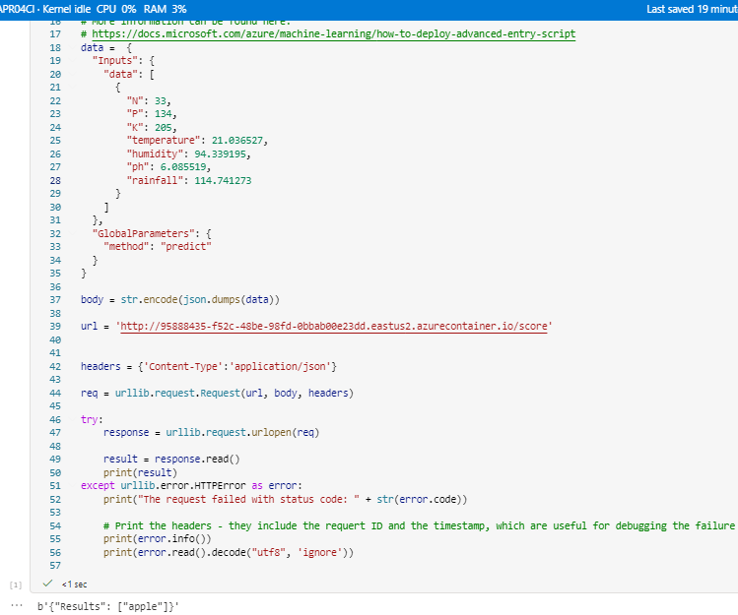
Automated ML
Created DataSet
Created Automated ML Job
Select task type as classification and data
Best Model
MaxAbsScaler, LightGBM with accuracy as 0.99000
Test Model

Slide 7
Thank you

